Slide 1
Laparoscopic Inguinal Hernia

Slide 2
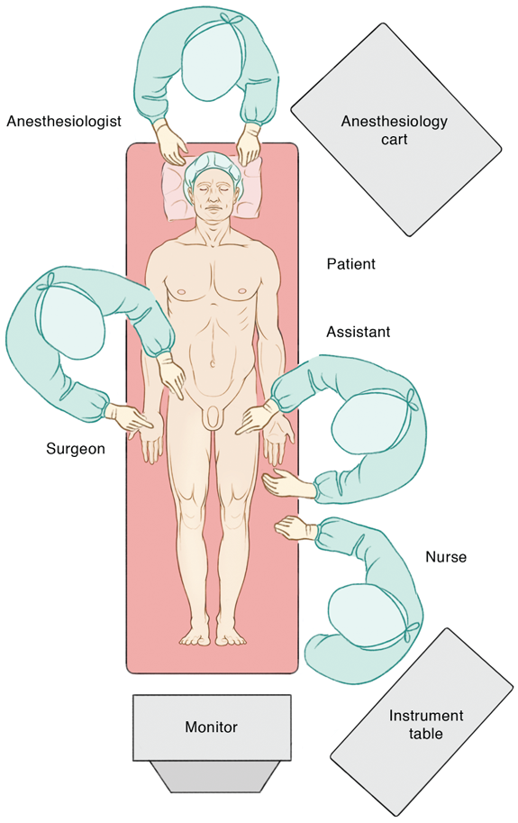
Setup
Contra-lateral arm tucked
Bladder decompressed (foley or urinate)
Monitor at foot of bed

Slide 3
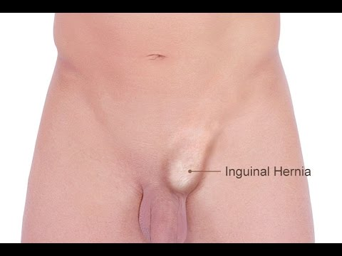
Port Placement?
Notes:
Too close: Can’t maneuver
Too low: Can’t place mesh

Slide 4
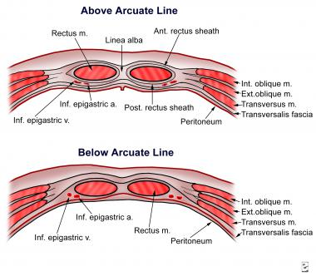

Slide 5
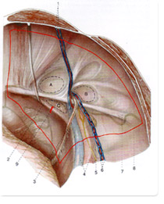
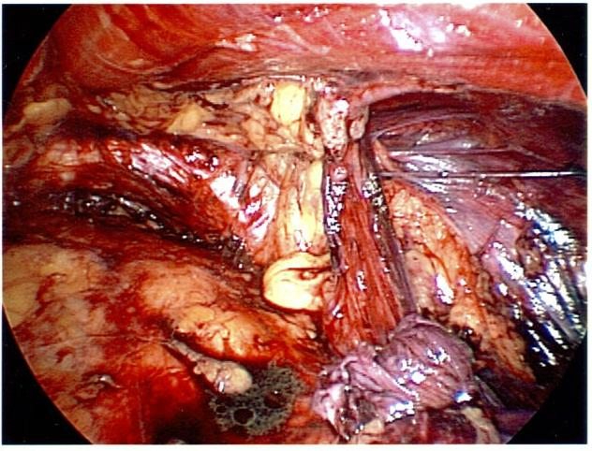
Notes:
Identify the structures on both images
Pubic tubercle
Coopers ligament
Inguinal ligament
Epigastric vessels
Spermatic cord
Iliac artery/vein
Triangle of doom
Triangle of pain
Hesselbach’s Triangle
Direct inguinal hernia
Femoral hernia
Indirect hernia

Slide 6
D
F
I
Notes:
Draw this (with animations)
Pubic tubercle and symphysis
Lateral Border of Rectus
Iliac artery and vein
Coopers ligament (superior surface of the superior ramus)
Inguinal ligament
Epigastric vessels
Direct hernia
Femoral hernia
Indirect hernia
Fold the paper in half on the blue line. This is your true view of the groin

Slide 7
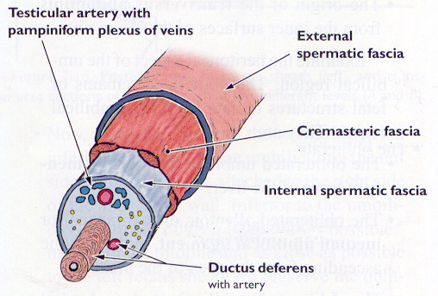
Indirect Hernia: Cord Structures
Outside
  Cremasters
  Genital nerve
Inside (Medial to Lateral)
  Hernia sac
  Vas deferens
  Testicular Artery
  Pampiniform plexus
  Cord lipoma
Notes:
List cord structures from medial to lateral

Slide 8
Five Key Steps of Surgery
Create peritoneal flap
Lateral dissection (open the preperitoneal space)
Delineate epigastric vessels
Medial, transition to pre-transversalis fascia space. Identify Hesselbach’s triangle (direct and femoral hernias)
Dissect cord, reduce hernia contents (indirect hernia sac and cord lipoma
Mesh placement

Slide 9
https://www.sages.org/video/tapp-repair-who-when-how-why/
https://www.sages.org/video/tapp-repair-of-a-large-incarcerated-inguinal-hernia/

Slide 10
Pearls
Dissect out peritoneum
  Tip to tip
  Avoid tearing peritoneum
Place mesh
  Taco shell
  Avoid cattywampus

Slide 11
D
F
I
Notes:
Yellow is hernia sac
Gray is mesh
Stars are fixation

