Slide 1
Laparoscopic Cholecystectomy

Slide 2
Techniques and tips

Slide 3
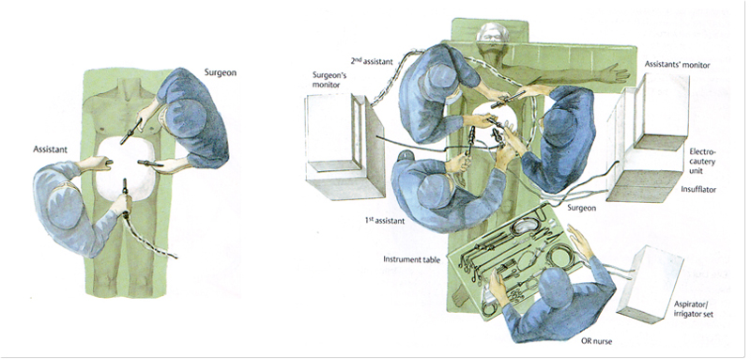
Setup
Considerations
Risk of conversion to open
Arm(s) in or out?
Right or left?
Exposing the rails
Estimated case duration?
Foley?
Cholangiogram?
How will c-arm get in

Slide 4
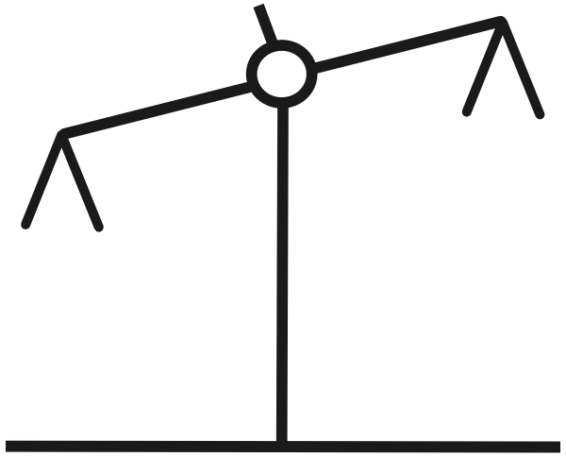
Entry: The LBJ Way
What factors affect your decision making?
Prior abdominal surgery
Obesity
Pregnancy
Options
Veress
Optical port
Hassan
Organ Injury
Frequency: 1 in 1000
Severity: (10/10) Bowel injury, Vascular injury
Hernia
Frequency: 3 in 10 versus 1 in 100
Severity: (5/10) Reoperation

Slide 5
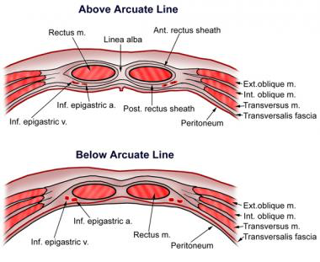
Entry Technique
Layers Abdominal Wall
Techniques
LUQ Veress Needle
https://www.youtube.com/watch?v=1ogA0pIWCW0
0-2.29
RUQ Optical Port
https://www.youtube.com/watch?v=AJH_tq_YrkE
1.15-22.5
Hassan
https://www.youtube.com/watch?v=Hf5DU2WQpjw
3.37-8.20

Slide 6
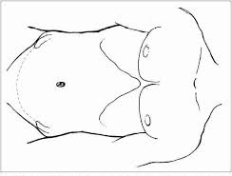
Port Placement: The LBJ Way
Retraction
5 mm port
Mid-clavicular line, subcostal
Peri-umbilical
5 mm port
Below/above umbilicus*
Subxiphoid
11/12 mm port
2-3 cm below xiphoid
Aim slightly toward the RUQ
Extraction site

Slide 7
Atmosphere
SQ Fat
Rectus
Preperitoneal Fat
Falciform
Peritoneal Cavity
Gallbladder
Small changes in angles lead to big changes
Aim for junction of the falciform and peritoneum

Slide 8
Port Placement: The LBJ Way
Retraction
5 mm port
Mid-clavicular line, subcostal
Peri-umbilical
5 mm port
Below/above umbilicus*
Subxiphoid
11/12 mm port
2-3 cm below xiphoid
Aim slightly toward the RUQ
Extraction site
Lateral
5 mm port
Lateral in line with camera port*

Slide 9
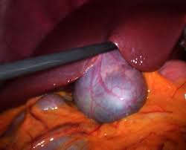
Retraction

Slide 10
Retraction
Learning Points
Try to grab side-to side
Grabbing front to back risks tearing the gallbladder
Grab toward the “under-side” of the gallbladder
Lift “up-and-over”

Slide 11
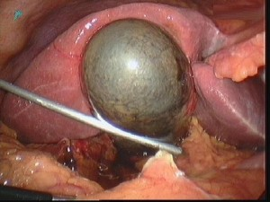
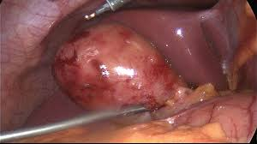
Retraction: Challenges
Distended Gallbladder
Decompression
At the point of retracting grasper to minimize spillage
`

Slide 12
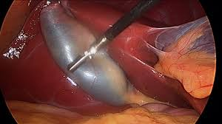
Exposure

Slide 13
Exposure

Slide 14
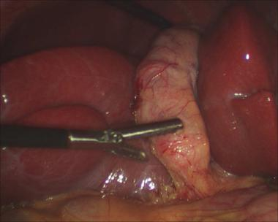
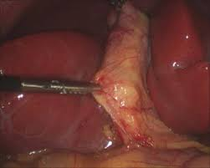
Exposure

Slide 15
Exposure
Learning Points
Grab a small to medium bite (1/3 to 1/2 width) of the infundibulum (hartmans pouch)
Avoid bunching the gallbladder and rather, splay the gallbladder open
Lock the grasper tightly
Retract by towing the tips lateral using the port as a fulcrum

Slide 16
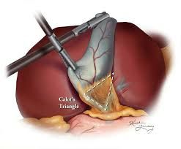
Dissection
Identify where you predict calot’s triangle
How would you start this dissection?

Slide 17
Start Lateral (safest)
Make a small opening in the peritoneum
Weakest point is at corners
Small bites with tap-tap-tap of heat
Peel like opening a book
Where is the weakest point of the peritonum?

Slide 18
Start Lateral (safest)
Make a small opening in the peritoneum
Weakest point is at corners
Small bites with tap-tap-tap of heat
Peel like opening a book

Slide 19
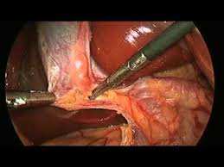
Dissection

Slide 20
Culture of Safety
http://www.sages.org/safe-cholecystectomy-program/
Use the Critical View of Safety (CVS) method of identification of the cystic duct and cystic artery during laparoscopic cholecystectomy
Perform an Intra-operative Time-Out during laparoscopic cholecystectomy prior to clipping, cutting or transecting any ductal structures
Understand the potential for aberrant anatomy in all cases
Make liberal use of cholangiography or other methods to image the biliary tree intraoperatively
Recognize when the dissection is approaching a zone of great danger and halt the dissection before entering the zone. Finish the operation by a safe method other than cholecystectomy if conditions around the gallbladder are too dangerous
Get help from another surgeon when the dissection or conditions are difficult

Slide 21
Critical View
Three criteria are required to achieve the CVS:
The hepatocystic triangle is cleared of fat and fibrous tissue. The hepatocystic triangle is defined as the triangle formed by the cystic duct, the common hepatic duct, and inferior edge of the liver. The common bile duct and common hepatic duct do not have to be exposed
The lower one third of the gallbladder is separated from the liver to expose the cystic plate. The cystic plate is also known as liver bed of the gallbladder and lies in the gallbladder fossa.
Two and only two structures should be seen entering the gallbladder

Slide 22
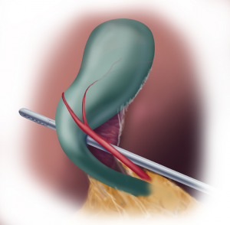
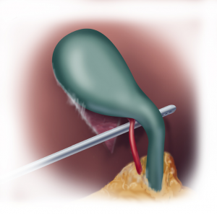
Anterior
Posterior

Slide 23
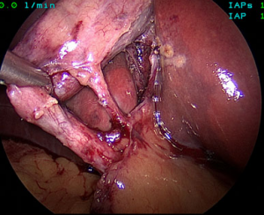
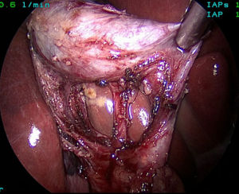
https://www.youtube.com/watch?feature=player_embedded&v=m9tnvd2uMfs
https://www.youtube.com/watch?feature=player_embedded&v=ufjXHnb-qsg
Anterior view
Posterior view

Slide 24
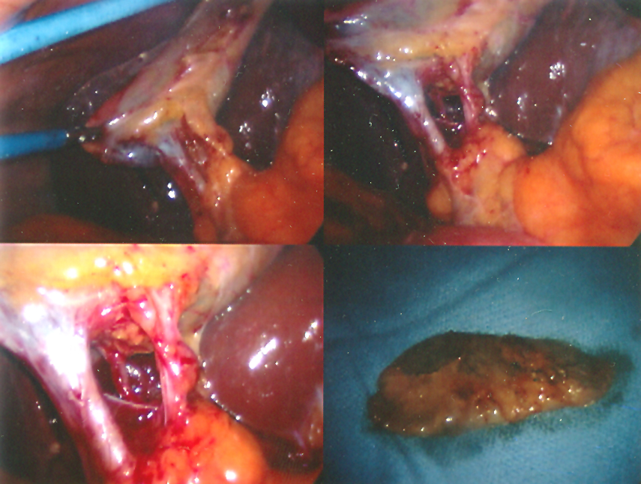
Anterior and Posterior Cystic Artery

Slide 25
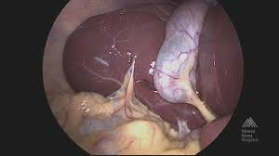
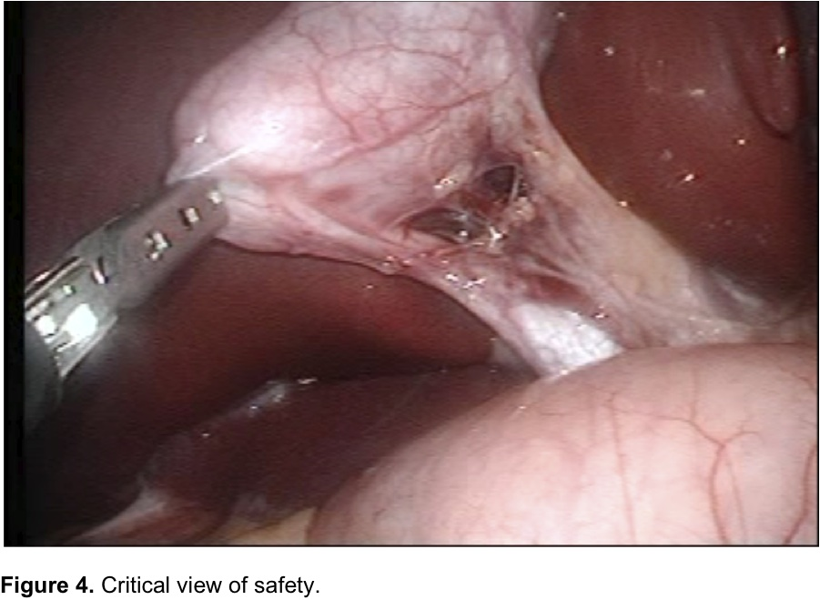
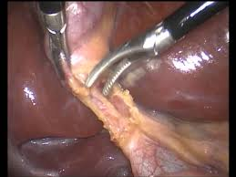
Poor Exposures

Slide 26
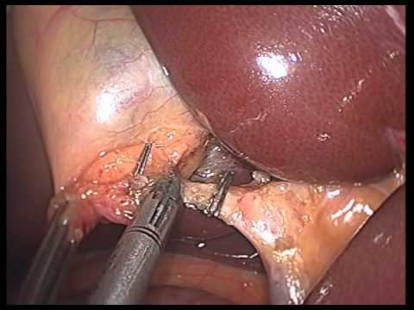
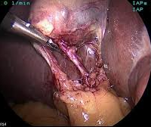
Poor Exposure
Learning Points
3 requirements for critical view of safety: (1) hepatic cystic triangle, (2) free lower 1/3 gallbladder, (3) 2 structures
To improve exposure of critical view, incise the peritoneum in front and back of gallbladder

Slide 27
Duct Securement

Slide 28
Duct Securement

Slide 29
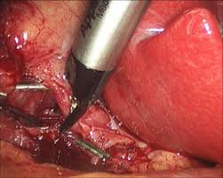
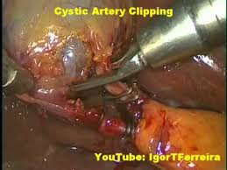
Duct Securement
NO
YES

Slide 30
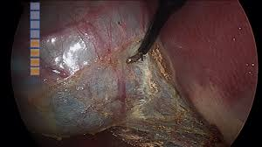
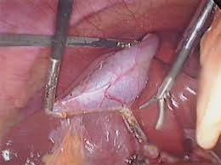
Gallbladder dissection
Perforate

Slide 31
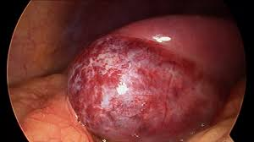
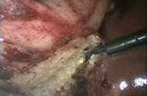
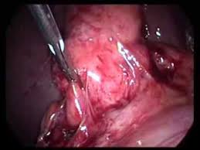
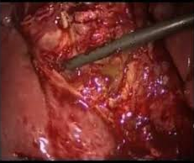
Gallbladder Dissection

Slide 32
Challenge for Next Week
Videotape a lap chole
Compare it to an expert lap chole
http://www.sages.org/video-category/laparoscopic-cholecystectomy/
Identify 1-2 skills to improve at next weeks lab
Questions?

Slide 33
Videos
Is this a top 20 technique?
https://www.youtube.com/watch?v=9eazGJc9WC0
Critical view
https://www.youtube.com/watch?v=zIFs4X6a4TI
https://www.youtube.com/watch?v=MT3IcujtHJ0
CBD injury, now what?
https://www.youtube.com/watch?v=wDXATkOt0yk

